Slide 1
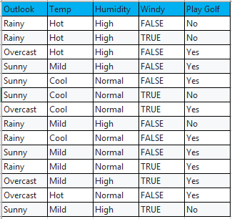
Input Attributes
(Categorical)
Target value
(Real Number)

Slide 2
Calculate “Gini Index” of Each Input Attribute
Calculate weighted “Gini Index” of Each Input Attribute
Consider Input Attribute with Lowest “Weighted Gini Index” value as Root Element
Divide the dataset into Sub-Branches(Sub-Partitions)
IF Gini = 0
Leaf Node
Yes
No

Slide 3
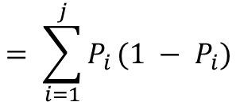
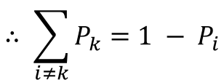
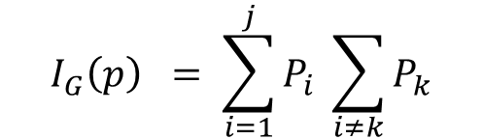
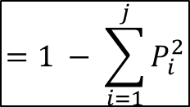
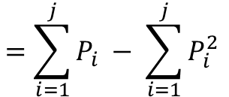
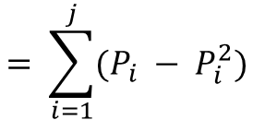
Gini Index Formula:
$$I_{G}\left(p\right) = \sum_{i=1}^{j}{P_{i}} \sum_{i≠k}{P_{k}}$$
$$= \sum_{i=1}^{j}{P_{i }(1 − P_{i})}$$
$$∴ \sum_{i≠k}{P_{k}=1 − P_{i}}$$
$$= \sum_{i=1}^{j}{(P_{i} − P_{i}^{2})}$$
$$=\sum_{i=1}^{j}{P_{i}} − \sum_{i=1}^{j}{P_{i}^{2}}$$
$$=1 − \sum_{i=1}^{j}{P_{i}^{2}}$$

Slide 4
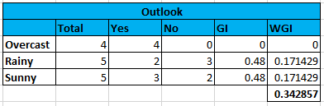











Gini Index(Gini Impurity) of Outlook:
$$Gini\left(Outlook, Overcast\right)=1 − {\left(\frac{4}{4}\right)}^{2}− {\left(\frac{0}{4}\right)}^{2}$$
$$\text{= 1 – }\text{1}\text{ – 0}$$
$$\text{= 0}$$
$$Gini\left(Outlook, Sunny\right)=1 − {\left(\frac{2}{5}\right)}^{2}− {\left(\frac{3}{5}\right)}^{2}$$
$$Gini\left(Outlook, Rainy\right) =1 − {\left(\frac{3}{5}\right)}^{2}− {\left(\frac{2}{5}\right)}^{2}$$
$$\text{= 1 – 0.16 – 0.36}$$
$$\text{= 1 – }\text{0.36}\text{ – 0}\text{.16}$$
$$\text{= 0.48}$$
$$\text{= 0}\text{.48}$$
$$Gini\left(Outlook\right)= \left(\frac{4}{14}\right) ×0 + \left(\frac{5}{14}\right) ×0.48+ \left(\frac{5}{14}\right) ×0.48$$
$$=0+0.171+0.171$$
$$=0.342$$

Slide 5
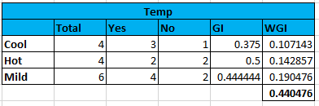











Gini Index(Gini Impurity) of Temp:
$$Gini\left(Temp, Cool\right)=1 − {\left(\frac{3}{4}\right)}^{2}− {\left(\frac{1}{4}\right)}^{2}$$
$$\text{= 1 – }\text{0.5625}\text{ – 0}\text{.0625}$$
$$\text{= 0}\text{.375}$$
$$Gini\left(Temp, Hot\right)=1 − {\left(\frac{2}{4}\right)}^{2}− {\left(\frac{2}{4}\right)}^{2}$$
$$Gini\left(Temp, Mild\right) =1 − {\left(\frac{4}{6}\right)}^{2}− {\left(\frac{2}{6}\right)}^{2}$$
$$\text{= 1 – 0.}\text{25}\text{ – 0.}\text{25}$$
$$\text{= 1 – }\text{0.444}\text{ – 0}\text{.111}$$
$\text{= 0.}$5
$$\text{= 0}\text{.445}$$
$$Gini\left(Temp\right)= \left(\frac{4}{14}\right) ×0.375 + \left(\frac{4}{14}\right) ×0.5+ \left(\frac{6}{14}\right) ×0.445$$
$$=0.107+0.142+0.190$$
$$=0.440$$

Slide 6
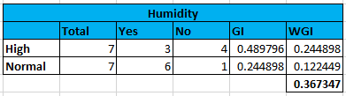








Gini Index(Gini Impurity) of Humidity:
$$Gini\left(Humidity, High\right)=1 − {\left(\frac{3}{7}\right)}^{2}− {\left(\frac{4}{7}\right)}^{2}$$
$$Gini\left(Humidity, Normal\right)=1 − {\left(\frac{6}{7}\right)}^{2}− {\left(\frac{1}{7}\right)}^{2}$$
$$\text{= 1 – 0.}\text{183}\text{ – 0.}\text{326}$$
$$\text{= 1 – }\text{0.734}\text{ – 0}\text{.02}$$
$$\text{= 0.}\text{489}$$
$$\text{= 0}\text{.244}$$
$$Gini\left(Humidity\right)= \left(\frac{7}{14}\right) ×0.489 + \left(\frac{7}{14}\right) ×0.244$$
$$=0.249+0.122$$
$$=0.367$$

Slide 7
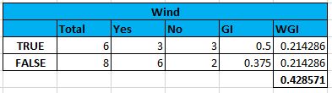








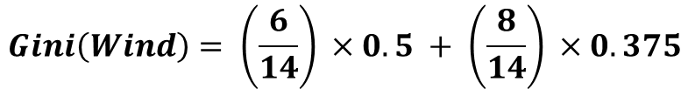
Gini Index(Gini Impurity) of Wind:
$$Gini\left(Wind, True\right)=1 − {\left(\frac{3}{6}\right)}^{2}− {\left(\frac{3}{6}\right)}^{2}$$
$$Gini\left(Wind, False\right)=1 − {\left(\frac{6}{8}\right)}^{2}− {\left(\frac{2}{8}\right)}^{2}$$
$$\text{= 1 – 0.}\text{25}\text{ – 0.}\text{25}$$
$$\text{= 1 – }\text{0.562}\text{ – 0}\text{.062}$$
$$\text{= 0.}\text{5}$$
$$\text{= 0}\text{.375}$$
$$Gini\left(Wind\right)= \left(\frac{6}{14}\right) ×0.5 + \left(\frac{8}{14}\right) ×0.375$$
$$=0.214+0.214$$
$$=0.428$$

